Slide 1
Tokens, Expressions and Control Structures

Slide 2
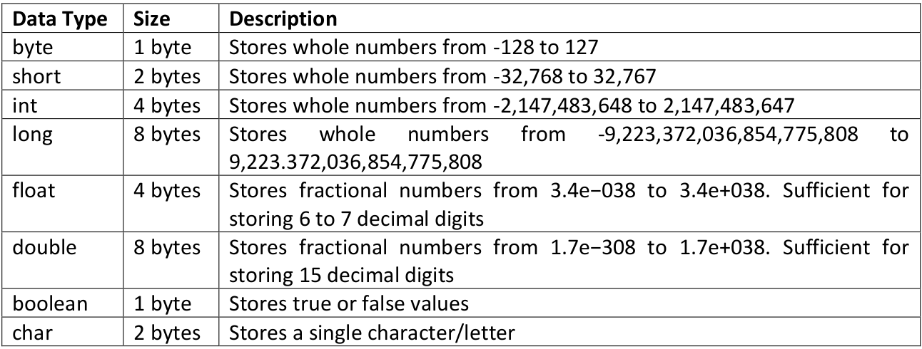
Primitive Data Types
8 primitive data types

Slide 3
User Defined Data Types
Programmer himself defines
Classes / Interfaces
variables are objects

Slide 4
Declaration , Identifiers , Literals, Expression / Variables and constants
expression:
construct made up of variables, operators, and method invocations, which are constructed according to the syntax of the language, that evaluates to a single value.
dataType identifier = literal
Example:
int a = 1;
char b = ‘b’;
double c = 2.3;
final int d = 9 ; ==> constant
int f;
f=20;

Slide 5
Variable Types
Local : Inside a method
Instance : Inside a class, related to objects
Static : related to class not objects
Instance and static variable have default values
int =>0
boolean => false
user defined => null

Slide 6
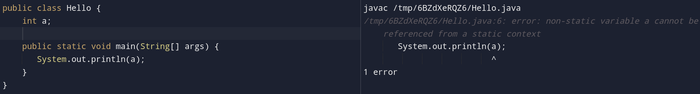
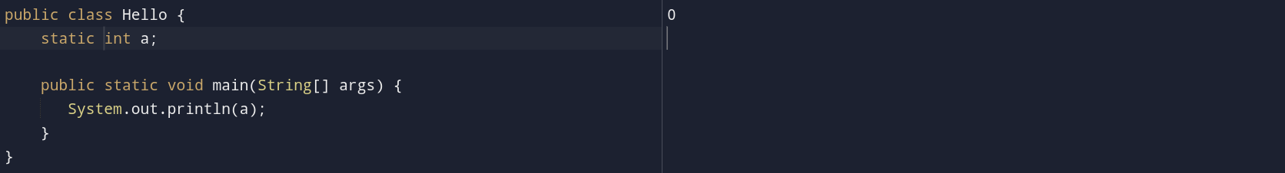
Static and non static context
static methods and static variables can only be accessed from static methods

Slide 7
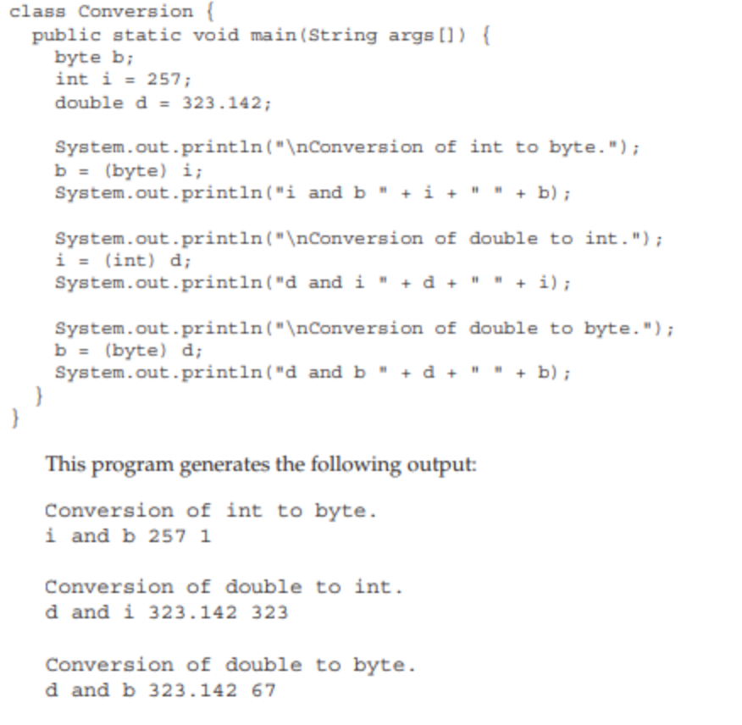
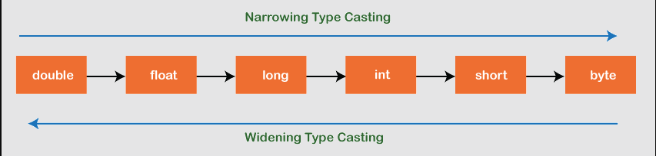
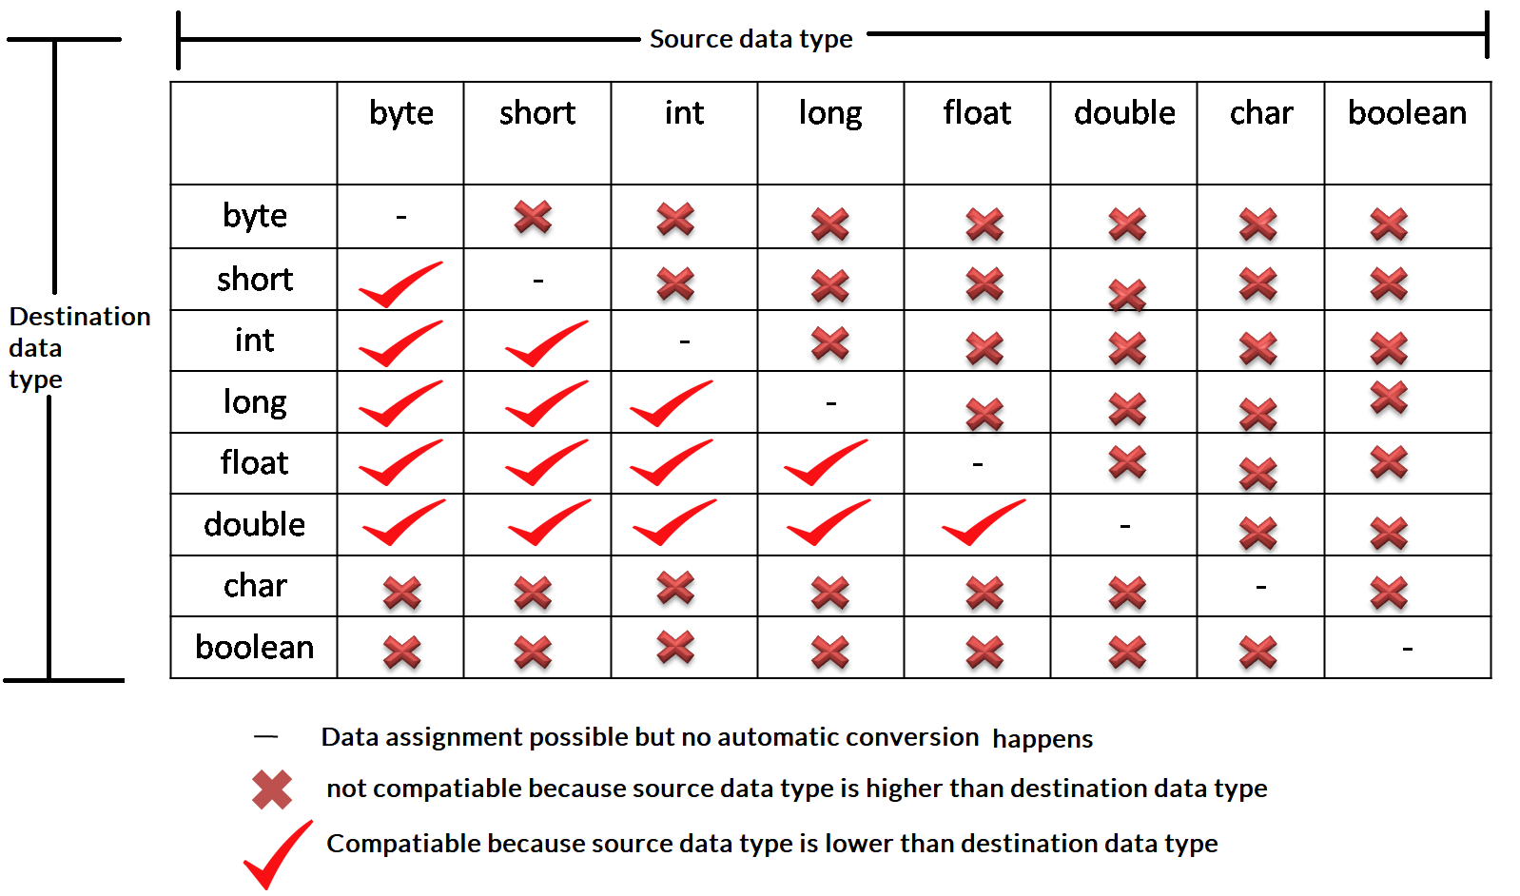
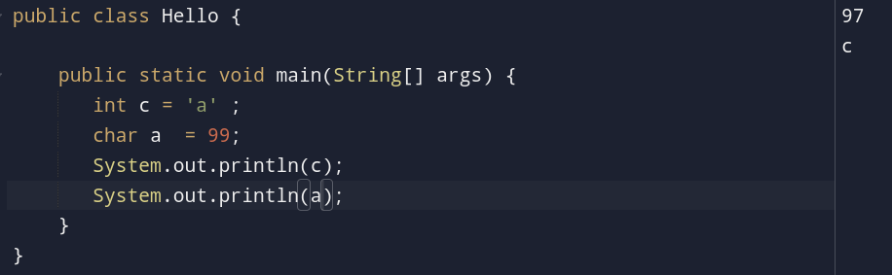
Type Conversion and casting

Slide 8
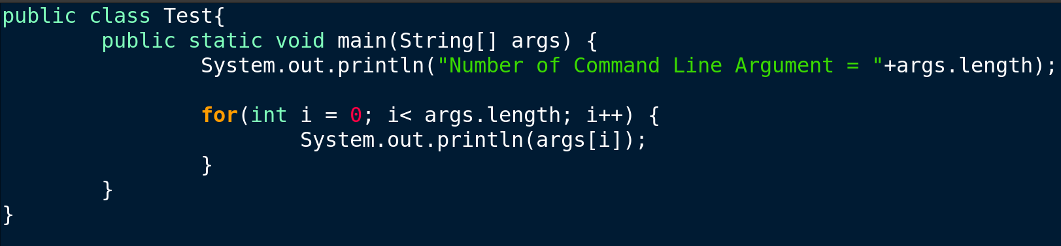

Command Line Arguments

Slide 9
Array
data structure that holds more than one homogenous value
int[] a = {1,2,3} => array with size 3
Variations
int[] a ={1,2,3}
int a[] ={1,2,3}
int[] a = new int[3]
index starts with 0
fixed size
finding length : a.length
accessing value a[index]

Slide 10
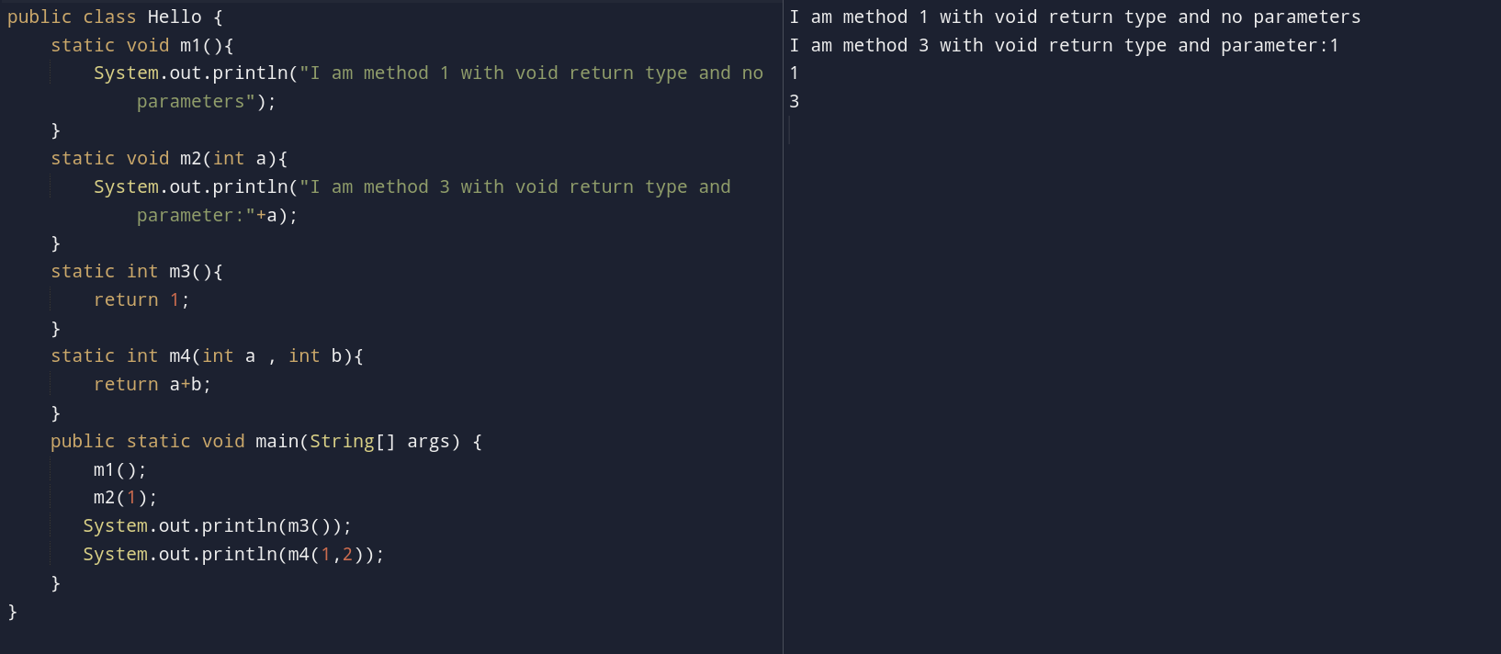
Methods
piece of code that performs a specific task and gain the flow
returnType methodName(ParameterDataType parameter){ statement }

Slide 11
Comments
line that do not execute
Single line : // single line comment
Multi line : /* comments in multiple line */

Slide 12
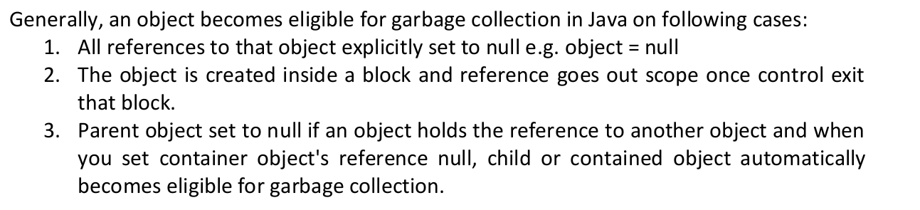
Garbage Collection
When Java programs run on the JVM, objects are created on the heap, which is a portion of memory dedicated to the program.
Eventually, some objects will no longer be needed.
The garbage collector finds these unused objects and deletes them to free up memory.

Slide 13
Operators
Operands
Literals around operations
Types
Unary : One operand ( +a)
Binary : Two operands (a+b)
Ternary : 3 operands (? :)

Slide 14
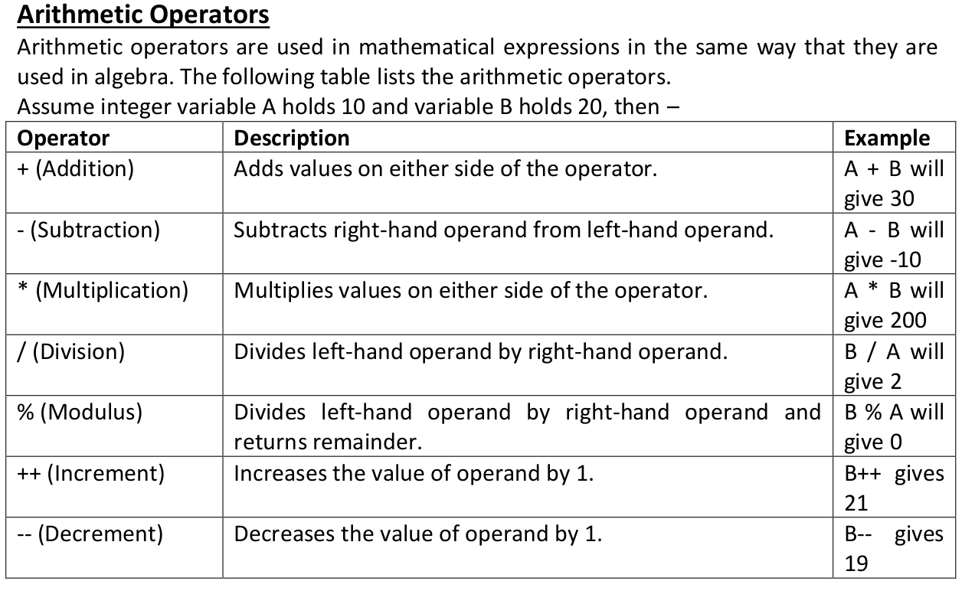
Operators : Arithmetic

Slide 15
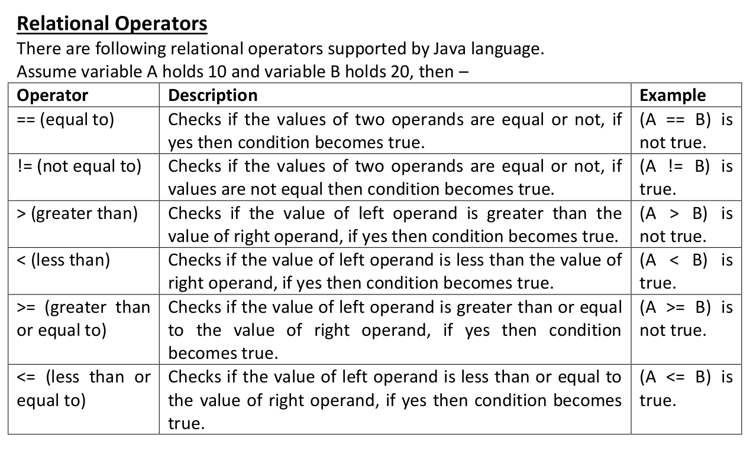
Operators : Relational

Slide 16
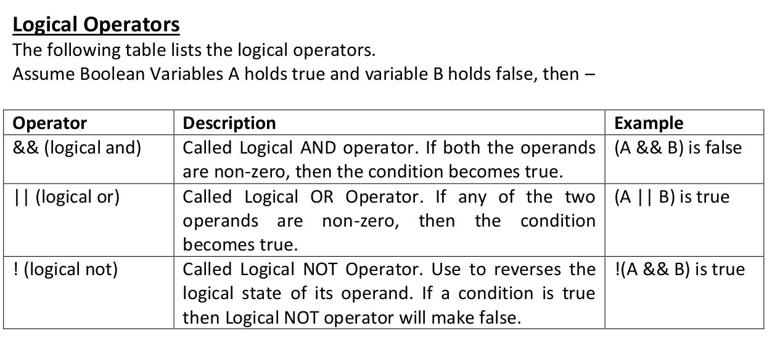
Operators : Logical

Slide 17
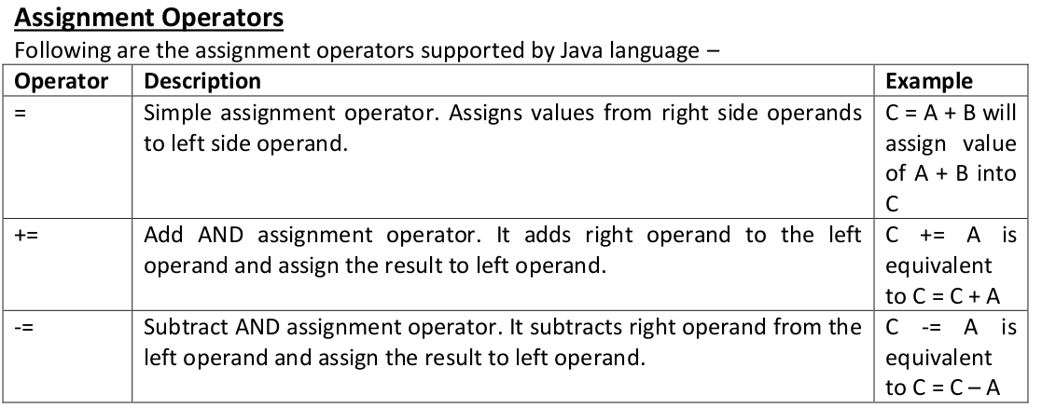
Operators : Assignment

Slide 18
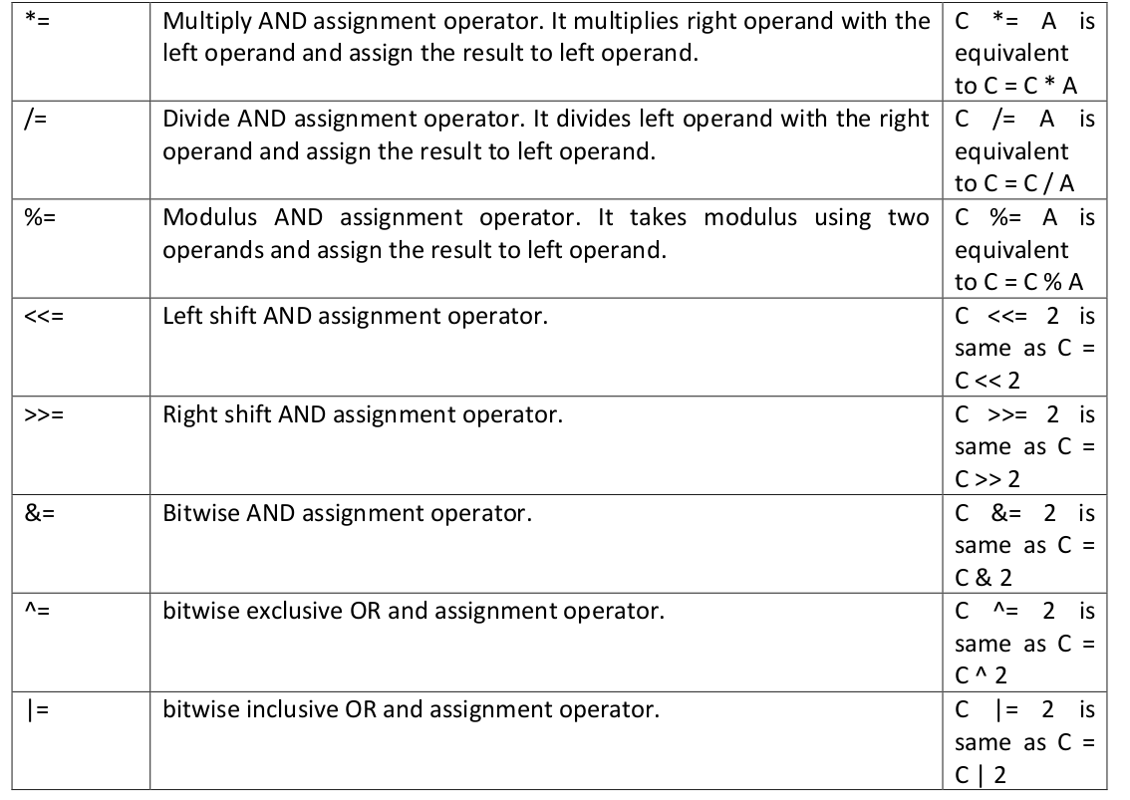
Operators : Assignment

Slide 19
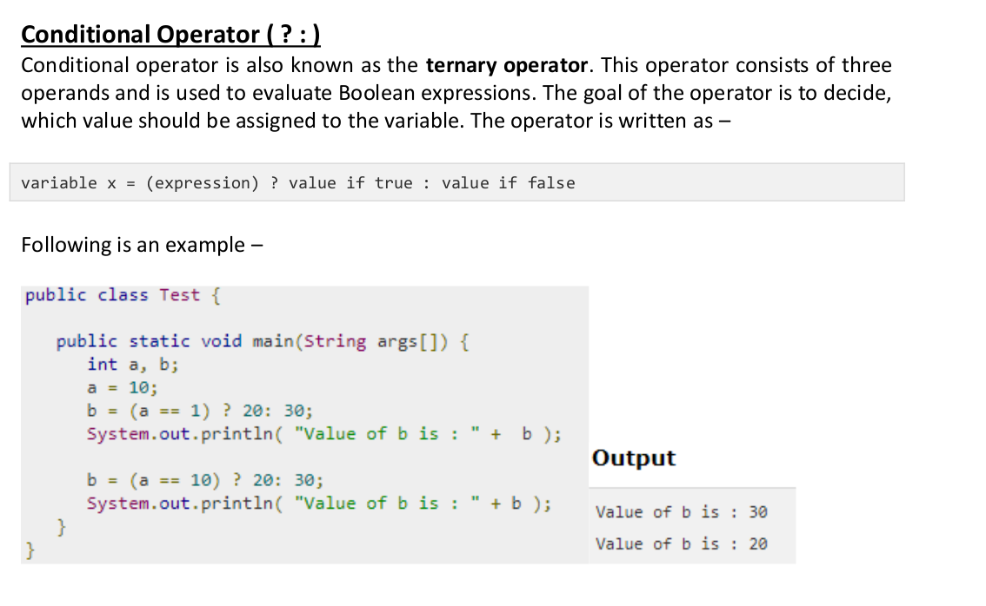
Operators : Conditional

Slide 20
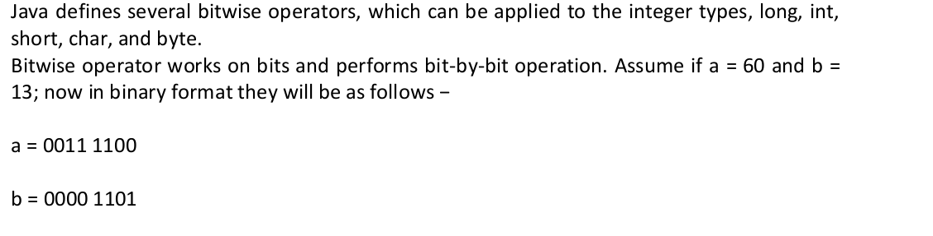
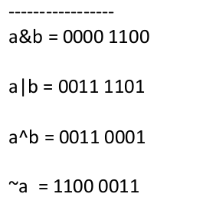
Operators : Bitwise

Slide 21
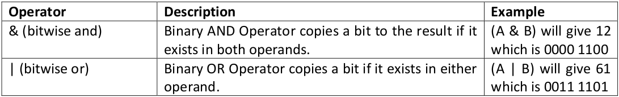
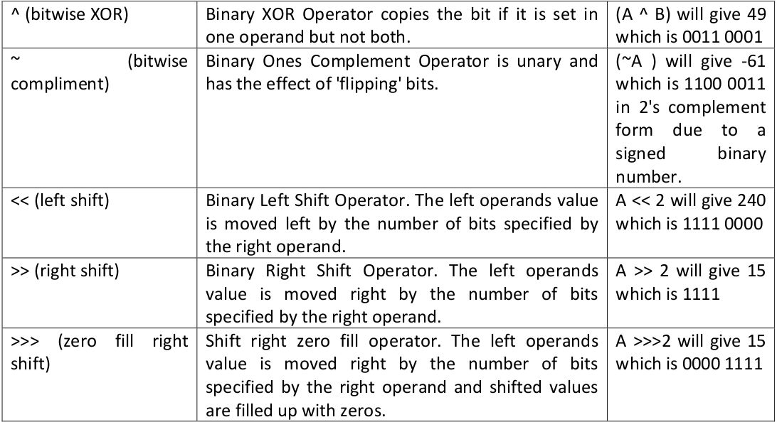
Operators : Bitwise

Slide 22
Control Statement
Selection statements : conditional
if..else
nested if
if...elseif ladder
switch
Iteration Statement : repetation
do..while
while
for
nested for
Jump Statements : flow control
break
continue
return

Slide 23

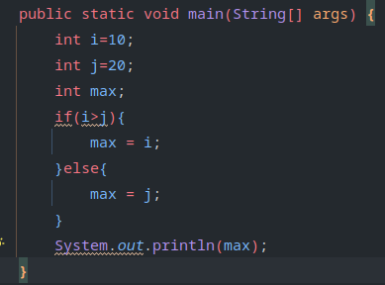
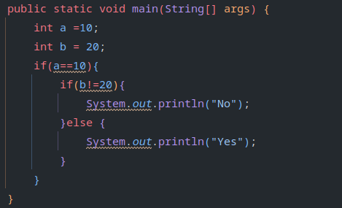
Control Statement : Selection(If..esle, nested if)

Slide 24
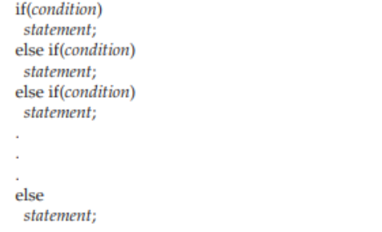
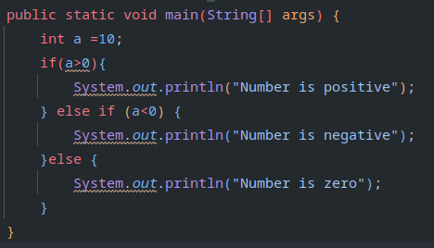
Control Statement : Selection(If..esleif ladder)

Slide 25
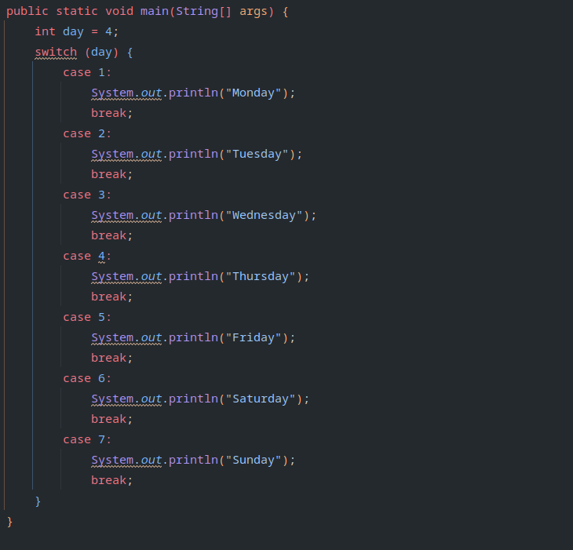
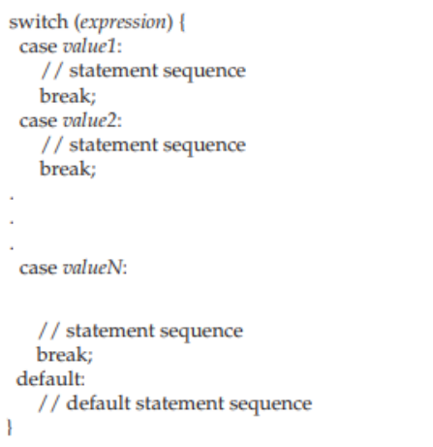
Control Statement : Selection(Switch)

Slide 26
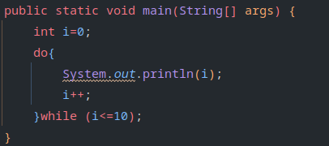
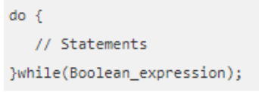
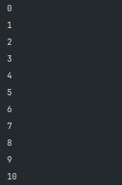
Control Statement : Iteration(do..while / execution first)

Slide 27
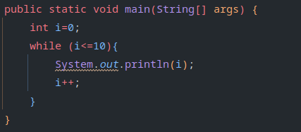
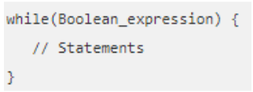
Control Statement : Iteration(while / condition first)

Slide 28
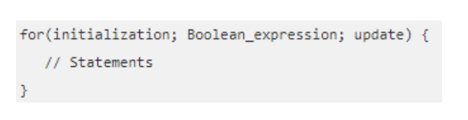
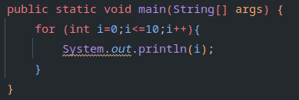
Control Statement : Iteration(for/ condition first)

Slide 29
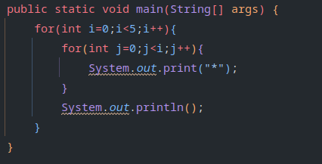

Control Statement : Iteration(nested for)

Slide 30
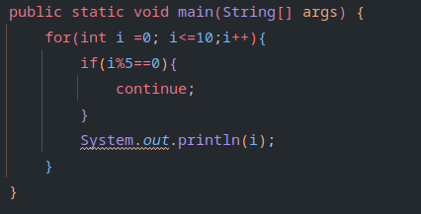
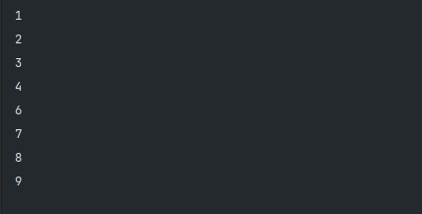
Control Statement : Jump(continue)
Skips a certain statement

Slide 31
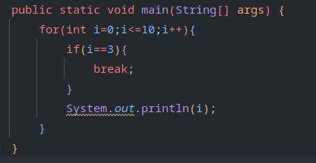

Control Statement : Jump(break)
Exits the loop

Slide 32
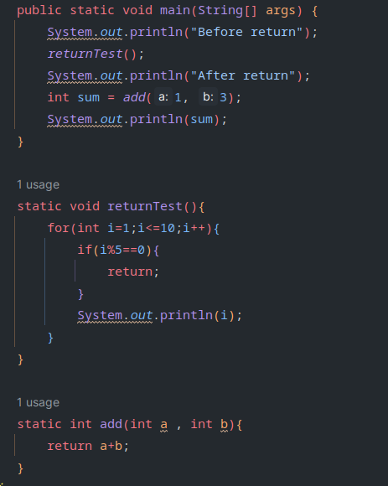
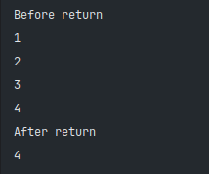
Control Statement : Jump(return)

